Slide 1



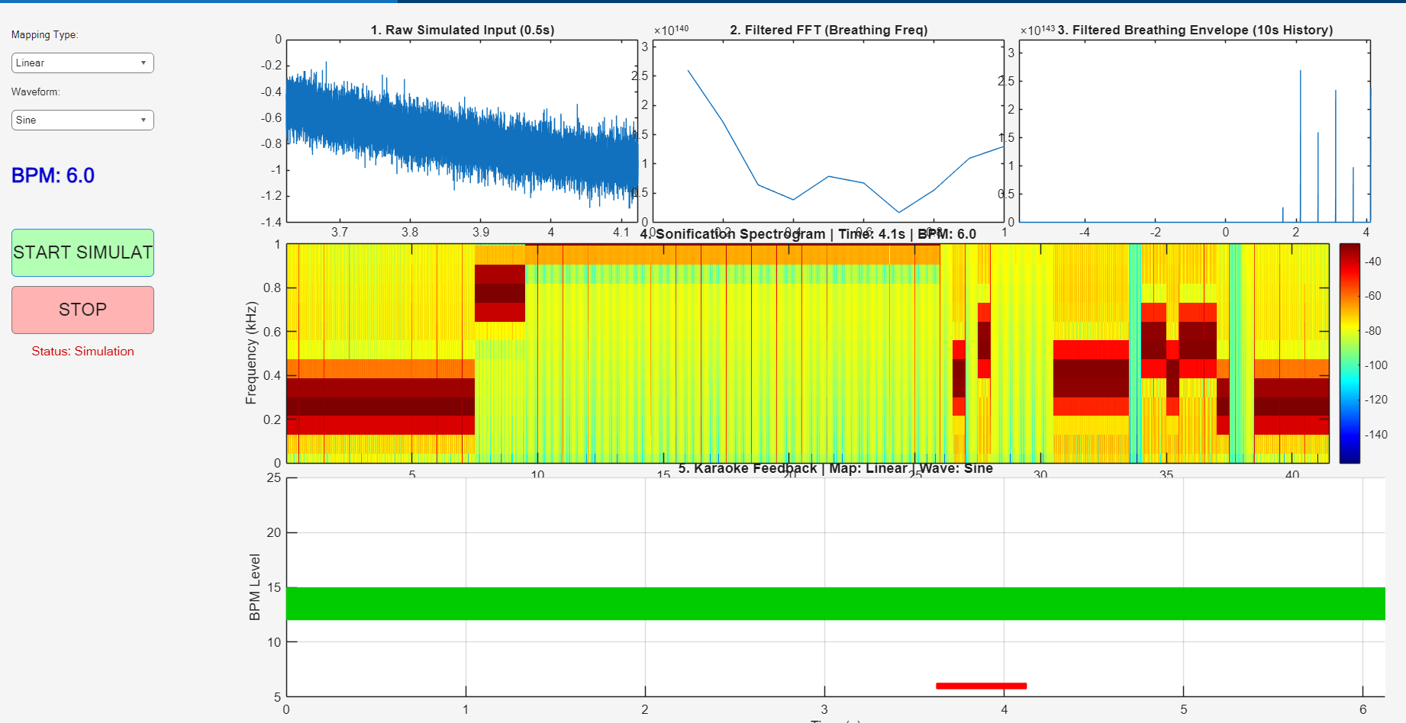

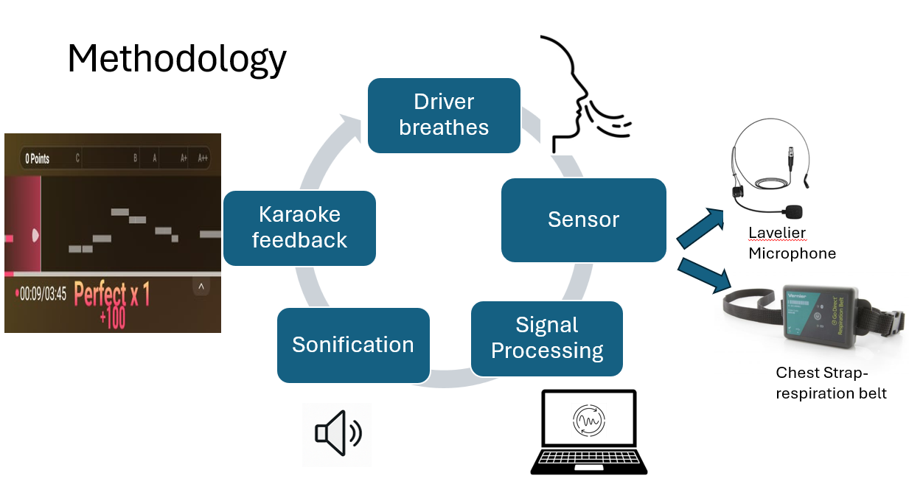
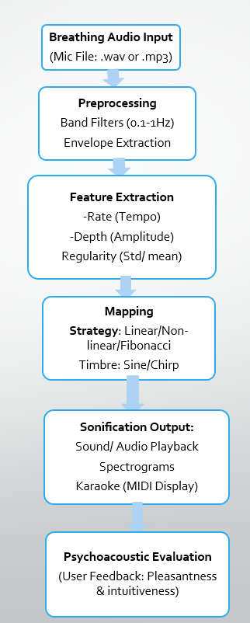
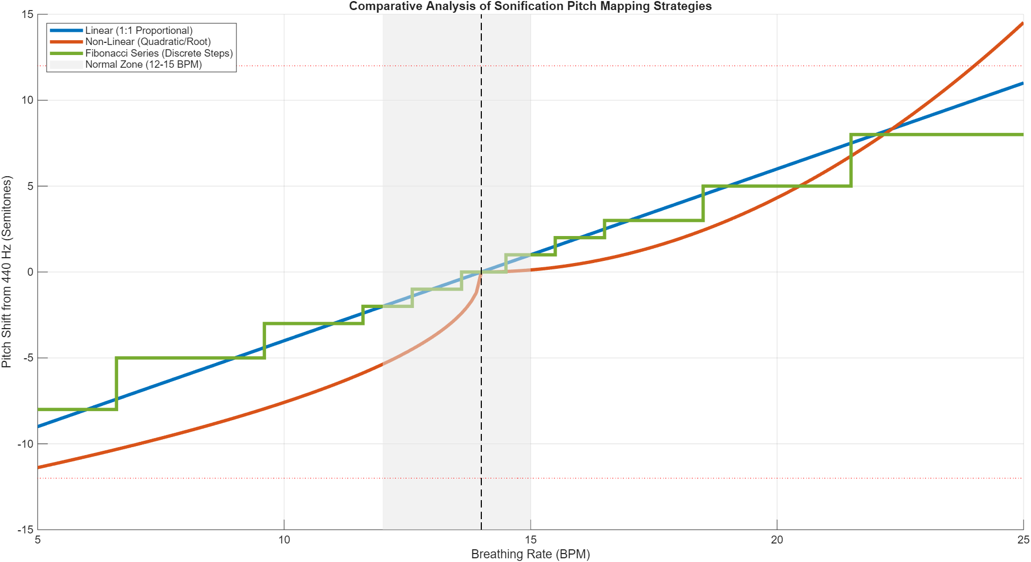
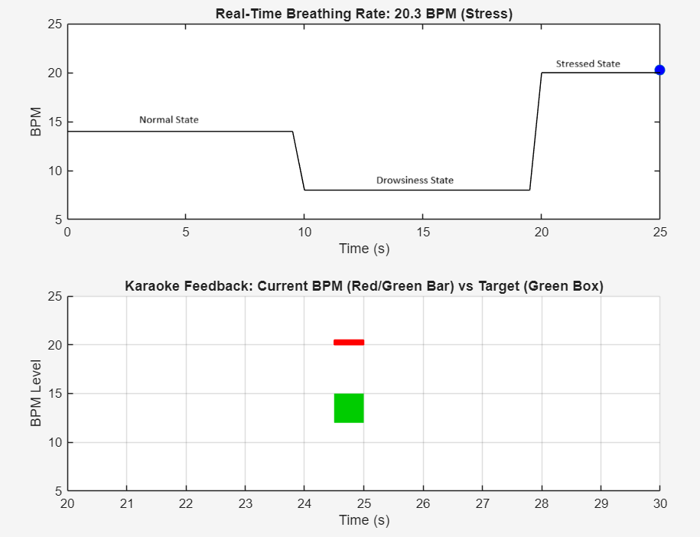
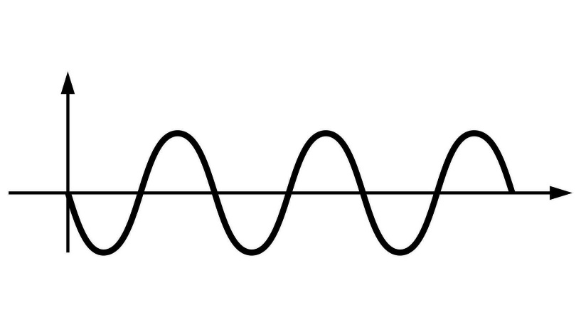
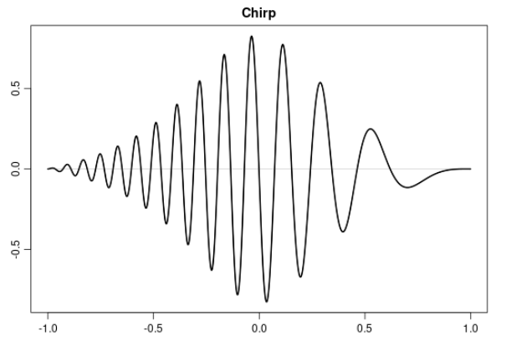
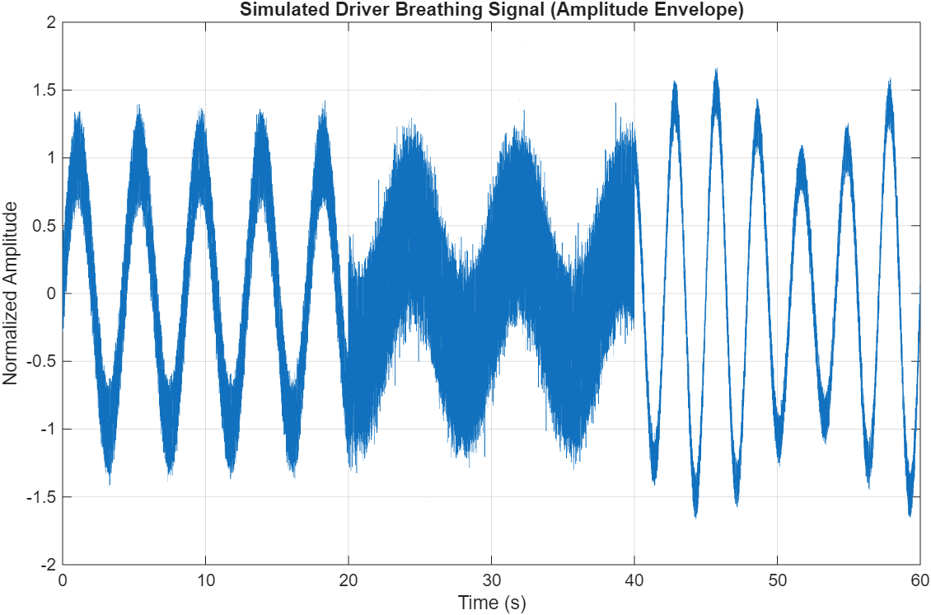
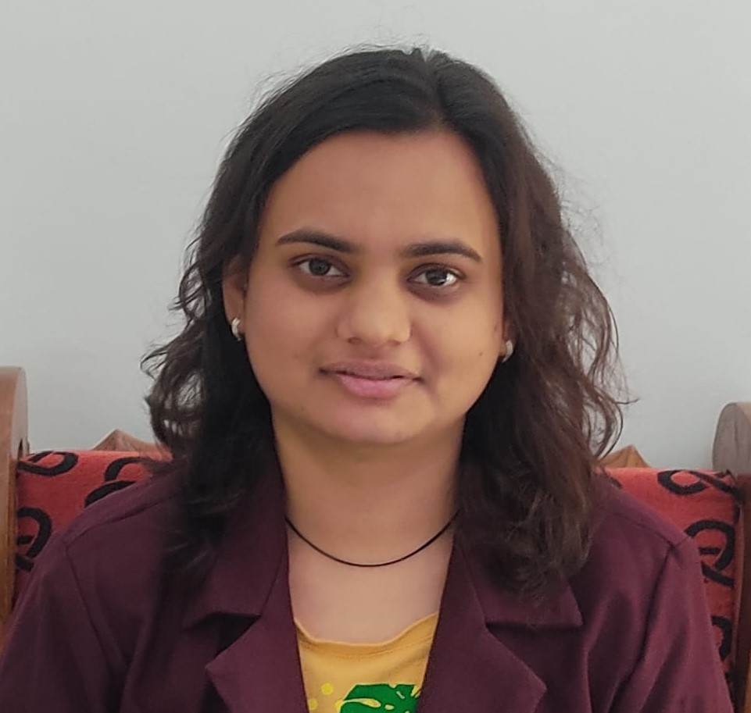

Breathing Sonification for Early Detection of Driver Fatigue
JUILI DEEPAK GULHANE
FY MTech Automotive Engineering
ABSTRACT :
This project proposes a novel karaoke-style breathing sonification framework that converts real-time respiration into intuitive auditory feedback. Drivers compare their physiological rhythms to a reference ideal pattern, enabling self-regulation and early recognition of abnormal signals. The research integrates human-computer interaction, psychoacoustics, and biomedical signal processing to develop a low-cost, non-intrusive biofeedback system. Applications extend to driver safety, wellness training, and healthcare monitoring.
INTRODUCTION:
The number of fatigue-related crashes remains significant, especially in long-haul transport and commercial driving. Drowsiness and even minute declines in alertness can lead to delayed reaction times, impaired decision-making, and increased crash risk.
Physiological signals (breathing, heart rate variability) provide an earlier indicator of driver fatigue onset, compared to purely behavioural measures(e.g., camera-based eye tracking, steering behaviour monitoring).
By converting breathing into an auditory/visual form (sonification) and leveraging interactive “karaoke” style feedback, we aim to engage the driver and Co-driver actively promoting breathing regulation, alertness, and thus safer mobility.
Biofeedback (e.g., subtle cues when breathing slows or heart‐rate decouples) signals the driver and co-driver before critical fatigue sets in, potentially enabling corrective action - rest break, alertness intervention.
SCOPE OF WORK:
To design a real-time system that converts breathing patterns into sound cues.
To compare sonification with different mappings (linear Vs non-linear Vs Fibonacci series) and Sine Vs. Chirp waveforms.
SIMULATION / EXPERIMENTAL SETUP:
INFERENCES:
  Spectrogram indicates reduced periodic energy at low frequencies during fatigue simulation.
  Linear mapping showed higher tonal clarity, easy to interpret but less natural flow, good for alerts.
  Non-linear mapping is gentle near target, providing comfort; highly aggressive at extremes, signaling immediate danger.
  Fibonacci mapping showed harmonic and perceived ‘musical’ quality, good for self-regulation and long-term biofeedback.
  Sine wave creates pure tone, maximizes clarity of alarms.
  Chirp wave creates textured tone, reduces auditory fatigue.
  The study demonstrates that sonification is not a single concept, but a set of design choices. The optimal system for driver fatigue is likely a hybrid model.
  A Chirp Waveform (for long-term comfort) combined with a Non-Linear Mapping (for low intrusiveness + high-urgency warnings) may provide the most effective real-world balance between driver comfort and critical safety alerts.
  FUTURE WORK:
In-vehicle testing, ML classification of fatigue states, integration with ADAS.
Can be extended to breath training apps (for mindfulness, stress relief and sleep. Also beneficial for athletes, swimmers, singers)
Karaoke framework can also be adapted to other applications using Sonification as comparative audio feedback model where a live or simulated signal is audibly compared to a reference (healthy or ideal) pattern, useful for detection even by laymen.
REFERENCES
Hermann, T., Hunt, A., & Neuhoff, J. G. (Eds.). (2011). The Sonification Handbook. Logos Publishing House.
Landry, Steven, Maryam Fakhr Hosseini, David Tascarella, and Myounghoon Jeon. "Listen to Your Drive: An In-Vehicle Sonification Prototyping Tool for Driver State and Performance Data," paper no. ACM 978-1-4503-4654-2/16/10, Adjunct Proceedings of the 8th International Conference on Automotive User Interfaces and Interactive Vehicular Applications (Automotive UI ’16), ACM Press, Ann Arbor, MI, USA, 2016.
Sonification of breathing sample showing spectrograms, and Karaoke Feedback for different mappings. For real-time live demo, scan the QR code →
Mapping Strategy
Sine
Chirp
Core Idea
Breathing Sample
STUDENT POSTER PRESENTATION – SAFE MOBILITY - SIAT 2026
Photograph of Author

